Slide 1
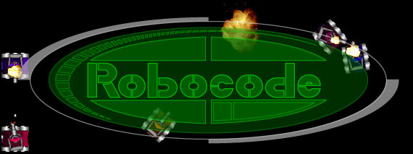
Robocode
Some Methods and Ideas

Slide 2
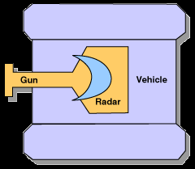
Robot anatomy 101
Just like the real thing …
it has a gun that rotates
a radar on top that also rotates
tank, gun and radar can rotate independently
default, all aligned
sorry no sound ….

Slide 3
moving your Robot
Some basic commands …
turnRight(double degree) and turnLeft(double degree) turn the robot by a specified degree.
ahead(double distance) and back(double distance) move the robot by the specified pixel distance; these two methods are completed if the robot hits a wall or another robot.
turnGunRight(double degree) and turnGunLeft(double degree) turn the gun, independent of the vehicle's direction.
turnRadarRight(double degree) and turnRadarLeft(double degree) turn the radar on top of the gun, independent of the gun's direction (and the vehicle's direction).
None of these commands will return control to the program until they are completed.

Slide 4
Controlling the Gun, Radar & Tank
When the vehicle is turned, the direction of the gun (and radar) will also move, unless indicate differently by calling the following methods:
setAdjustGunForRobotTurn(boolean flag): If the flag is set to true, the gun will remain in the same direction while the vehicle turns.
setAdjustRadarForRobotTurn(boolean flag): If the flag is set to true, the radar will remain in the same direction while the vehicle (and the gun) turns.
setAdjustRadarForGunTurn(boolean flag): If the flag is set to true, the radar will remain in the same direction while the gun turns. It will also act as if setAdjustRadarForRobotTurn(true) has been called.

Slide 5
Methods exist for getting information about the robot:
getX() and getY() get the current coordinate of the robot.
getHeading(), getGunHeading(), and getRadarHeading() get the current heading of the vehicle, gun, or radar in degrees.
getBattleFieldWidth() and getBattleFieldHeight() get the dimension of the battlefield for the current round.

Slide 6
Firing ....
Firing and controlling damage.
each robot starts out with a default "energy level," and is considered destroyed when its energy level falls to zero.
when firing, the robot can use up to three units of energy. The more energy supplied to the bullet, the more damage it will inflict on the target robot.
fire(double power) and fireBullet(double power) are used to fire a bullet with the specified energy (fire power).
the fireBullet() version of the call returns a reference to a robocode.Bullet object that can be used in advanced robots.

Slide 7
Events ....
Here are some of the more frequently used events:
ScannedRobotEvent. Handle the ScannedRobotEvent by overriding the onScannedRobot() method; this method is called when the radar detects a robot.
HitByBulletEvent. Handle the HitByBulletEvent by overriding the onHitByBullet() method; this method is called when the robot is hit by a bullet.
HitRobotEvent. Handle the HitRobotEvent by overriding the onHitRobot() method; this method is called when your robot hits another robot.
HitWallEvent. Handle the HitWallEvent by overriding the onHitWall() method; this method is called when your robot hits a wall.
That's all we need to know to create some pretty complex robots…

Slide 8
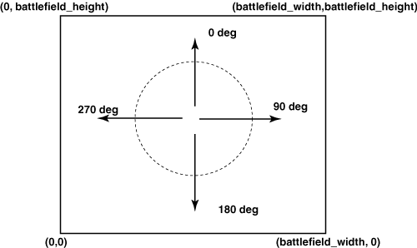
coordinates and direction
Notes:
This shows the coordinates and direction conventions used by Robocode. The "LeftLimit" custom event that we have defined will be triggered whenever our robot has a heading of 90 degrees or less. The "RightLimit" condition will be triggered whenever the heading is 270 degrees or higher.

Slide 9
Information about the Robot
getHeading()
  Direction the robot body is facing, 0 <= h < 360 (0=north, 90=east, 180=south, 270=west)
getGunHeading()
  Direction gun is pointing (absolute angle relative to north, just like getHeading()
getRadarHeading()
  Direction radar is pointing
getEnergy()
  Amount of energy remaining. Energy is lost when hit by a bullet or when a fired bullet misses its target. Robot is destroyed when energy reaches zero.

Slide 10
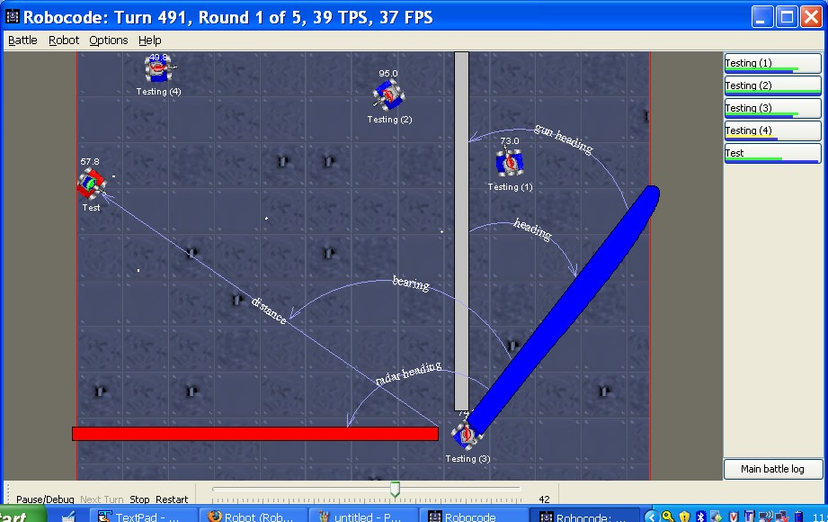
Robocode Screen

Slide 11
Robocode: basics
Coords. are (x,y), with bottom left as (0,0)
Heading: degrees, straight up = 0, pos. clockwise (0 <= heading <= 360)
Bearing: relative angle from your heading, pos. clockwise (-180 <= bearing <= 180)
Hitting a wall or another bot ends turn
Energy: costs 1 to fire, receive energy when one of your bullets hits enemy
Radar is mounted on gun

Slide 12
Robocode: numbers
Max velocity: 8
Accel: 1/frame, Decel: 2/frame
Max turning rate = 10 -.75*getVelocity()
Turret turn rate = 20 degrees/frame
Radar turn rate = 45 degrees/frame
Damage = 4 * pwr,
if pwr>1 damage+=2*(pwr-1)

Slide 13
Robocode: numbers
Power = .1 to 3
Bullet speed = 20 – 3 * pwr
Heat = 1 + pwr/5
Heat dissipates at .1/frame

Slide 14
Robocode: getting started
Launch the robocode engine & select Editor from the Robot menu
Select New->Robot from the File menu of the editor
Enter a name for your robot and your initials
Given a robot template

Slide 15
Robocode: coding
public void run() {
//setColors(Color.red,Color.blue,Color.green);
while(true) {
// Replace the next 4 lines with any behavior ahead(100);
turnGunRight(360);
back(100);
turnGunRight(360);
}
}

Slide 16
Robocode: coding
ahead(double dist)
back(double dist)
fire(double pwr)
scan()
turnGunLeft/Right(double degrees)
turnLeft/Right(double degrees)
turnRadarLeft/Right(double degrees)
stop()/resume()

Slide 17
Robocode: coding
double getBattleFieldHeight/Width()
double getGunHeat()
int getOthers()
double getX()
double getY()

Slide 18
Robocode: coding
onBulletHit(BulletHitEvent e)
onHitByBullet(HitByBulletEvent e)
onHitRobot(HitRobotEvent e)
onHitWall(HitWallEvent e)
onScannedRobot(ScannedRobotEvent e)

Slide 19
Robocode: coding
Each event class has its own set of member functions that can be called to assess details about the event
ex. Calling e.getBearing() in onScannedRobot()
Any additional classes used by your robot should be placed in the same file after your robot class

Slide 20
Robot Actions
ahead(distance)
  Move robot forward specified distance along its heading.
back(distance)
  Move robot in reverse the specified distance.
turnRight(angle), turnLeft(angle)
  Turn robot body (change heading by angle).
turnGunRight(angle), turnGunLeft(angle)
  Turn gun (change gun heading by angle)
  Radar is mounted on gun, so radar heading changes.
turnRadarRight(angle), turnRadarLeft(angle)
  Turn radar (change radar heading); don’t bother firing the gun when you see an opponent unless the radar heading and the gun heading are the same.

Slide 21
Events Handled by the Robot
onBulletHitBullet
  whenever your bullet is cancelled by another bullet from your opponent
onBulletHit
  whenever you successfully shoot another robot
onBulletMissed
  whenever you miss your opponent
onHitByBullet
  whenever an enemy successfully shoots your robot
onHitRobot
  whenever your robot hits another robot
onHitWall
  whenever your robot hits a wall (allowing you to turn or something instead
  of just sit with your face in the wall)
onScannedRobot
  whenever your robot’s radar scan bounces off another robot

Slide 22
Event Object Passed to Handler
onBulletHit
  BulletHitEvent e
    e.getEnergy() - how much energy the hit robot has left
    e.getName() - who did we hit?
onHitByBullet, onHitRobot, onHitWall
  e.getBearing() - where did the bullet come from?
  turnRight(e.getBearing()) faces the robot you hit, if the attacker
  doesn’t move.
  e.getName() - who shot me? (not available for HitWallEvent)
  e.isMyFault() - did I move into the other robot? (only HitRobotEvent)
onScannedRobot
  ScannedRobotEvent e
    e.getBearing() - -180 degrees up to 180 degrees indicating direction
    scanned opponent was seen relative to direction you are facing:
    0 in front, 180 in back, 90 to right, -90 to left
    e.getHeading() - where is opponent facing:
    0 is north, 90 is east, 180 is south, 270 is west
    e.getDistance() - how far is opponent
    e.getEnergy() and e.getVelocity() - opponent robot’s information

Slide 23
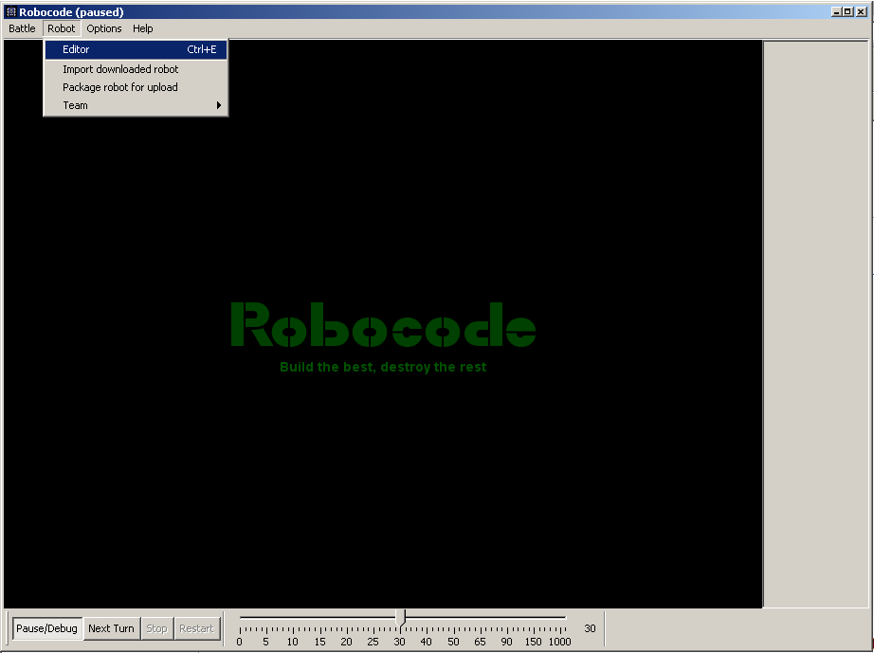
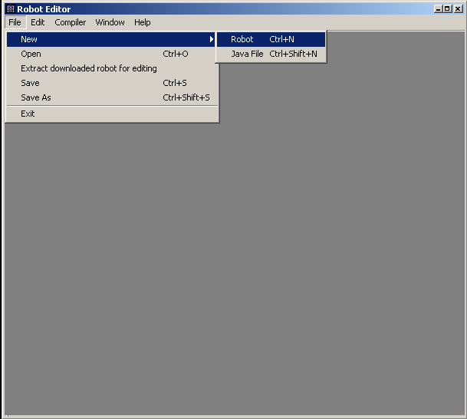
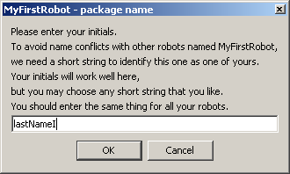
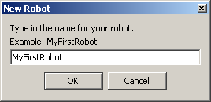
Creating Your First Robot

Slide 24
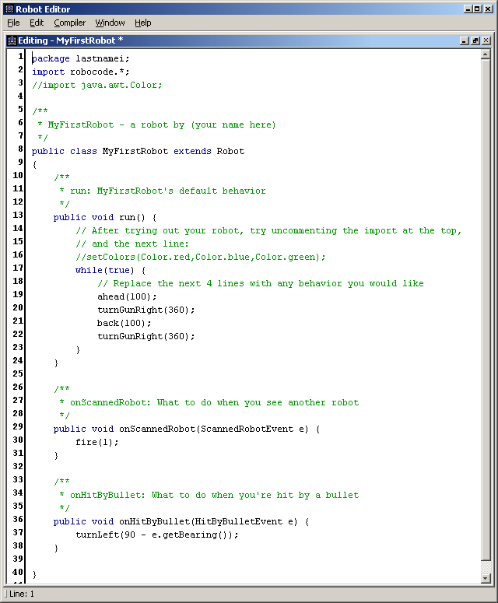

Slide 25
Compile
You can use any complier (i.e. Javac) or Jikes that comes with the editor in Robocode.
You can use the editor in Robocode, or any editor (i.e. notepad).
The compilation process translate commands into form computer can process quickly (machine language)
Battle finds compiled code and includes it in the list of robots when you import them.

Slide 26
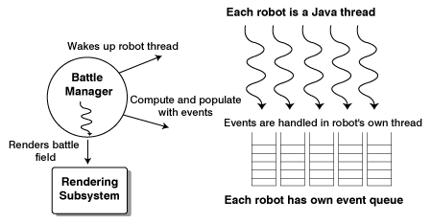
Battle simulator architecture
non-preemptive threading
coupled with the rendering capabilities provided by the JDK GUI and 2D graphics libraries
Notes:
Notice that each robot being simulated is on its own Java thread, leveraging the VM's native thread mapping wherever applicable. A battle manager thread is the controller of the system: it orchestrates the simulation and drives the graphical rendering subsystem. The graphical rendering subsystem itself is based on Java 2D and AWT.
Loose thread coupling
To alleviate potential problems with shared resources (and thus potentially deadlocking or choking the simulation engine), a very loose coupling is required between the battle manager thread and the robot threads. To implement this loose coupling, each robot thread is given its own event queue. The events for each robot are then fetched and processed in the robot's very own thread. This per-thread queuing effectively eliminates any potential contention between battle manager thread and robot thread, or between robot threads themselves.
Robocode internals
You can view the Robocode simulator engine as a simulator program that takes a set of plug-ins (custom robots) during run time; this set of plug-ins can make use of the API supplied (the robocode.Robot class's methods). Physically, each robot is an independent Java thread, and the run() method contains the logic that will be executed on the thread.
At any time, a robot thread can call an API supplied by its parent, the robocoode.Robot class. This will typically block the robot thread via an Object.wait() call.
The battle manager thread
A battle manager thread manages the robots, bullets, and rendering on the battlefield. The simulation "clock" is marked by the number of frames rendered on the battlefield. The actual frame rate is adjustable by the user.
In a typical turn, the battle manager thread wakes up each robot thread, and then waits for the robot to complete its turn (that is, calling a blocking API again). This wait interval is typically tens of milliseconds, and even the most complex robot tends to use only 1 or 2 milliseconds for strategy and computation with today's typical system speed.

Slide 27
Blocking vs non-blocking methods
Robot class:
turnRight()
turnLeft()
turnGunRight()
turnGunLeft()
turnRadarRight()
turnRadarLeft()
ahead()
back()
AdvancedRobot class:
setTurnRight()
setTurnLeft()
setTurnGunRight()
setTurnGunLeft()
setTurnRadarRight()
setTurnRadarLeft()
setAhead()
setback()
Notes:
Notice the pattern here: all of the new non-blocking calls begin with set. Using these calls, we can tell our robot to do multiple things at once. For example, take a look at part of the MultiMoveBot.java file.

Slide 28
Working with non-blocking method calls
public class MultiMoveBot extends AdvancedRobot {
...
public void run() {
...
setTurnRight(fullTurn);
setAhead(veryFar);
setTurnGunLeft(fullTurn);
Notes:
This code instructs MultiMoveBot to turn right, move ahead, then turn the gun left -- all at the same time during the next turn.
Note that all of the above methods return control to your program immediately without turning or moving the robot and the gun. Nothing will happen until you give control back to Robocode. You can give control back by making a blocking call (that is, any in the left column of the table above), or by using the special execute() method.

Slide 29
The execute() method
Giving control back to Robocode with a blocking method call:
while(true) {
waitFor(new TurnCompleteCondition(this));
toggleDirection();
}
Notes:
The waitFor() method is a blocking call. It will block until the condition specified is satisfied. In this case, we are telling Robocode to return control to us after it has completed the vehicle turn. Of course, since we have set up the robot to move ahead and turn at the same time, it will actually be moving in a curved motion.

Slide 30
The toggleDirection() method
private void toggleDirection() {
if (clockwise) {
setTurnLeft(fullTurn);
setBack(veryFar);
setTurnGunRight(fullTurn);
} else {
setTurnRight(fullTurn);
setAhead(veryFar);
setTurnGunLeft(fullTurn);
}
clockwise = ! clockwise;
}
Notes:
The toggleDirection() method is actually our own method. It reverses the robot's direction (and gun direction) each time it is called, as shown

Slide 31
Custom events …
public class CustomEventBot extends AdvancedRobot
{
...
public void run() {
...
addCustomEvent(
new Condition("LeftLimit") {
public boolean test() {
return (getHeading() <= quarterTurn);
};
}
);
addCustomEvent(
new Condition("RightLimit") {
public boolean test() {
return (getHeading() >= threeQuarterTurn);
};
}
);
Notes:
This code shows how to create two new custom events using a mechanism known as an anonymous class. Inside the addCustomEvent() method, we are defining a new subclass of the Condition class and overriding its test() method. This new subclass is anonymous, meaning it has no name. The argument, such as "LeftLimit", is passed as an argument to the constructor method of the Condition class.

Slide 32
coordinates and direction
Notes:
This shows the coordinates and direction conventions used by Robocode. The "LeftLimit" custom event that we have defined will be triggered whenever our robot has a heading of 90 degrees or less. The "RightLimit" condition will be triggered whenever the heading is 270 degrees or higher.

Slide 33
Handling custom events
public void onCustomEvent(CustomEvent ev) {
Condition cd = ev.getCondition(); System.out.println("event with " + cd.getName());
if (cd.getName().equals("RightLimit")) { setTurnLeft(fullTurn);
setTurnGunRight(fullTurn);
} else {
setTurnRight(fullTurn);
setTurnGunLeft(fullTurn);
}
}
Notes:
To handle these custom events, the AdvancedRobot class has an onCustomEvent() method that we can override. In our case, we switch the turn direction of the vehicle and gun, as shown
Together, our custom event definition and handler restrict the turn of the robot between 90 and 270 degrees, sending the robot into a twisting motion.

Slide 34
Interfaces and inner classes
The three key new features provided by AdvancedRobot are the ability to:
Carry out multiple movements simultaneously
Decide on the robot's action or strategy at every clock tick
Define and handle custom events
Notes:
While these features certainly provide a lot of capabilities for advanced robot builders, they do not tell us how to go about finding out where a target is (target location) and how to get close to it. This is a very basic question, but one that needs to be resolved if we want to create effective robots. There are at least two ways to approach this problem. We will first take a look at a simple way.

Slide 35
Looking at the DuckSeekerBot
public class DuckSeekerBot extends AdvancedRobot implements DuckConstants
{
boolean targetLocked = false;
Target curTarget = null;
Notes:
This simple bot will "target locate" sitting ducks (the most docile robot in the Robocode samples collection) on the battlefield, move in, and roast them.
Not surprisingly, this robot subclasses AdvancedRobot for extra flexibility. It also implements the interface DuckConstants and shares those constants.
If you take a look at DuckConstants.java, you will find the interface definition. In this case, it contains all the constants that we have been using all along (halfTurn, fullTurn, and so on.). Therefore, implementing the DuckConstants interface is a shorthand way to include all the constants into our class. In the code fragment above, notice that we created a variable called curTarget, of the type Target. But Target isn't part of the Robocode library, so what is it?

Slide 36
The Target member class
class Target {
...
public Target(String inname, boolean inalive, boolean inlocked) {
... }
public boolean isAlive() { ... }
public boolean isLocked() { ... }
...
} // of Target
Notes:
By declaring the class Target inside DuckSeekerBot as a member class, we have made it available for use inside DuckSeekerBot. As you examine the code, you will see that curTarget is used to hold the current target that is detected with the onScannedRobot() method. We use a very simplistic means of homing in on the target: we turn toward it, move in, then fire.

Slide 37
Homing in on our target
stop();
turnRight(evt.getBearing());
if (evt.getDistance() > safeDistance) ahead(evt.getDistance() - safeDistance);
Notes:
The DuckSeekerBot alternates between scanning for new ducks and locking in on a target.

Slide 38
Ok Lets wrap up … for now …
Getting the big picture on the battlefield: Vector, polymorphism, and java.Math
The DuckSeekerBot:
Scans for a duck target
Zooms in and roasts the target
Repeats until the entire flock is gone
An alternative approach to the same problem is this:
Scan for all the ducks that can be seen in the battlefield and build an "intelligence map"
Zoom in on the flock one at a time to eliminate them
Update the "map" constantly from scan information
This second approach achieves the same result as the first, but uses more intelligence. Most advanced robots use this sort of "big picture" information in formulating an instantaneous strategic decision. Learning how to maintain such a map will allow us to create robots with more sophisticated intelligence.
Get the idea ? Robocode really does expand your Java knowledge ☺
Notes:
Rock 'em, sock 'em Robocode documents complete this picture.
Available from the Robocode web site at Alphworks

